Slide 2
Evolution is not Science

Slide 3
An introduction to Atheism and Evolution

Slide 4
Atheism
the rejection of belief in the existence of deities
Evolution
All life on Earth is descended from a last universal ancestor

Slide 5
History of Atheism and Evolution

Slide 6
رسالة بولس الرسول الاوالي الي تيموثاوس 6
6: 20 يا تيموثاوس احفظ الوديعة معرضا عن الكلام الباطل الدنس و مخالفات العلم الكاذب الاسم
6: 21 الذي اذ تظاهر به قوم زاغوا من جهة الايمان
1Ti 6:20 O Timothy, keep that which is committed to thy trust, avoiding profane and vain babblings, and oppositions of science falsely so called:
1Ti 6:21 Which some professing have erred concerning the faith. Grace be with thee. Amen.

Slide 7
سفر الرؤيا 6
8 :10 ثم بوق الملاك الثالث فسقط من السماء كوكب عظيم متقد كمصباح و وقع على ثلث الانهار و على ينابيع المياه
8 :11 و اسم الكوكب يدعى الافسنتين فصار ثلث المياه افسنتينا و مات كثيرون من الناس من المياه لانها صارت مرة
Rev 8:10 And the third angel sounded, and there fell a great star from heaven, burning as it were a lamp, and it fell upon the third part of the rivers, and upon the fountains of waters;
Rev 8:11 And the name of the star is called Wormwood: and the third part of the waters became wormwood; and many men died of the waters, because they were made bitter.

Slide 8
1674 Matthias Knutzen
1700Jean Meslier
1796 James Hutton
Charles Lyell 1830
Charles Darwin 1859

Slide 9
من يريد تفاصيل الموضوع بالمراجع وشهادات العلماء يرجع لهذه اللنكات التي امامكم
http://drghaly.com/articles/display/12155
https://www.youtube.com/watch?v=ILZo0qg4zgU

Slide 11
Evolution is not Science

Slide 12
Charles Lyell 1830
I had conceived of the idea five or six years ago that if ever the mosaic chronology could be set down without giving offense, it would be in an historical sketch.
K.M. Lyell. “Life, Letters and Journals of Sir Charles Lyell” London, 1881, Vol 1 P. 253

Slide 13
Charles Darwin 1859
The Origin of Species

Slide 14
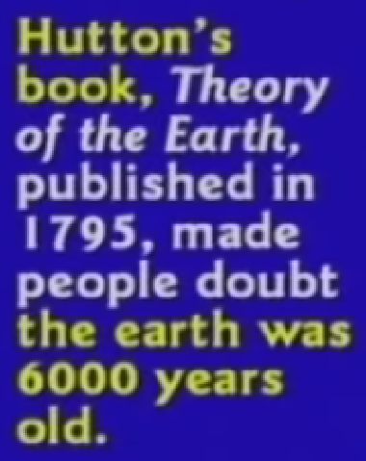
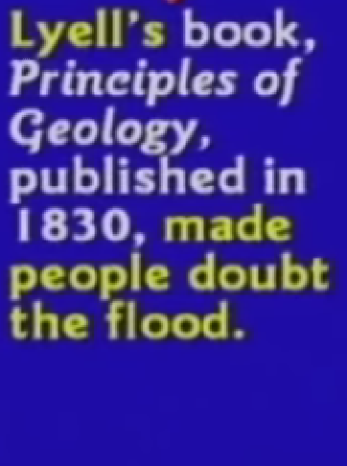
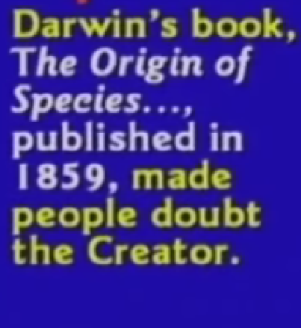

Slide 15
Darwin
Natural Selection and Inheritance of acquired characteristics

Slide 16
New Darwinism
Genetic drift and mutations combined with natural selection turned a few simple organisms into the diverse complex life we see today

Slide 17
Evolution = Variation
Macro-evolution = Micro-evolution

Slide 18
Most Evolutionists tell you that macro-evolution is just micro-evolution over longer periods of time. This is dreaming!
“The central question of Chicago conference was whether the mechanisms underlying micro-evolution can be extrapolated to explain the phenomena of macro-evolution. … The answer can be given as a clear, No.”
Roger Lewin, “Evolution theory Under Fire” Science Vol. 210, Nov 21 P 883

Slide 19
من يريد تفاصيل الموضوع بالمراجع وشهادات العلماء يرجع لهذه اللنكات التي امامكم
http://drghaly.com/articles/display/12156
https://www.youtube.com/watch?v=ZK0GJI5zWmA

Slide 21
Evolution is not Science

Slide 22
Evolution
Change over time
Evolution definition
The gradual development of something, especially from a simple to a more complex form.

Slide 23
Organic or Chemical evolution
Abiogenesis
Life arose spontaneously from non-life via unknown (supernatural) process = abiogenesis

Slide 24
Big Bang
Cosmic evolution
Explosion of infinitesimal molecule

Slide 25
Horizon problem
Flatness problem
Magnetic monopole problem
Antimatter problem
Generation I Stars problem

Slide 26
Chemical evolution
Stellar and planetary evolution

Slide 27
من يريد تفاصيل الموضوع بالمراجع وشهادات العلماء يرجع لهذه اللنكات التي امامكم
http://drghaly.com/articles/display/12157
https://www.youtube.com/watch?v=bfRsGpoSDEo

Slide 29
Evolution is not Science

Slide 30
Science
Predictions that are testable by experiment or observation.
Observable, Testable, Repeatable and Predictable
Evolution is not observable, testable, repeatable or predictable

Slide 31
Evolution is not observable, testable, repeatable or predictable
Evolution is the faith that does not fit the facts
Continuation is observable, testable, repeatable and predictable.
Creation is the faith that fit the facts

Slide 32
observational science historical science
experiments or inventions Explanation and assumptions

Slide 33
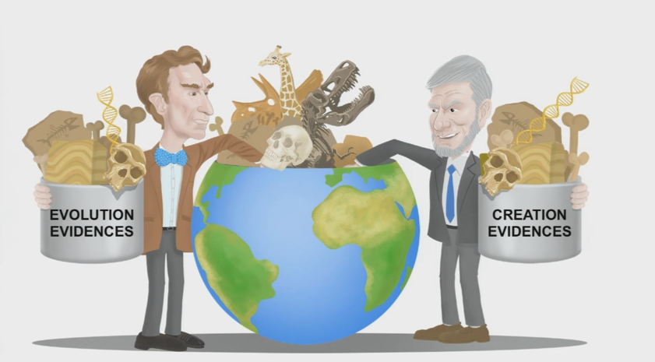

Slide 34
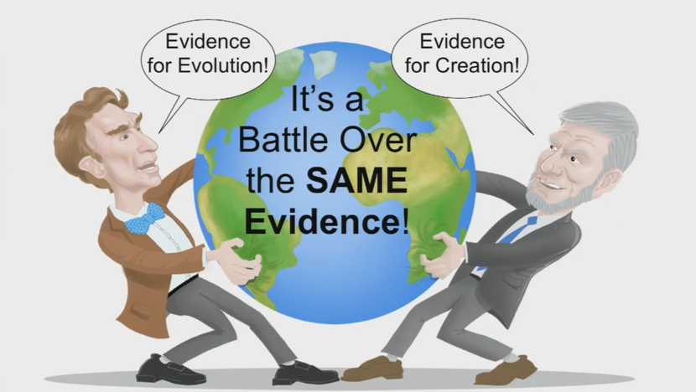

Slide 35
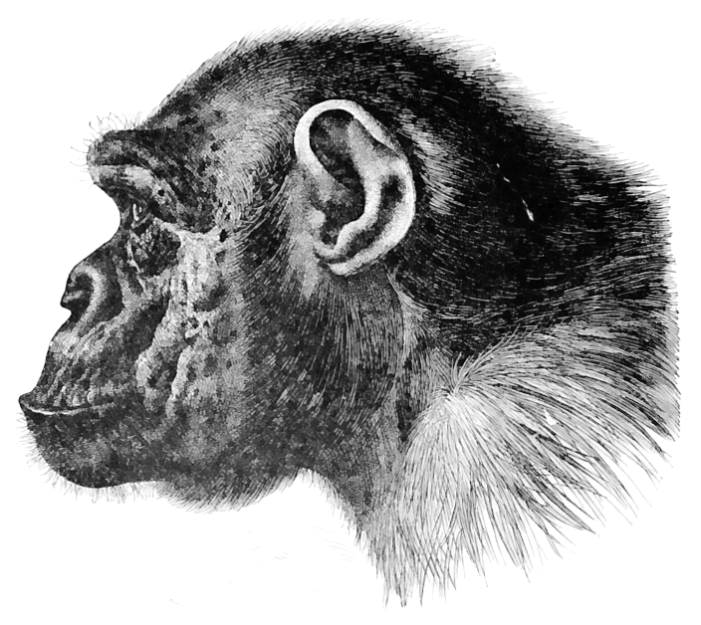

Slide 36
SCIENCE
Evolution or Creation

Slide 37
من يريد تفاصيل الموضوع بالمراجع وشهادات العلماء يرجع لهذه اللنكات التي امامكم
http://drghaly.com/articles/display/12154
https://www.youtube.com/watch?v=pRrcIPpipHA&list=UUAE2_S96xiltlHv3BkQX2ug

Slide 39
Evolution is not Science

Slide 40
Creation theory
The Holy Bible 1

Slide 41
The gap theory
1814

Slide 42
Day age theory
1857

Slide 43
The garden theory
~1860

Slide 44
سفر التكوين 1
1: 14 و قال الله لتكن انوار في جلد السماء لتفصل بين النهار و الليل و تكون لايات و اوقات و ايام و سنين
Gen 1:14 And God said, Let there be lights in the firmament of the heaven to divide the day from the night; and let them be for signs, and for seasons, and for days, and years:

Slide 45
رسالة يهوذا 1: 14
وَتَنَبَّأَ عَنْ هؤُلاَءِ أَيْضًا أَخْنُوخُ السَّابعُ مِنْ آدَمَ قَائِلاً: «هُوَذَا قَدْ جَاءَ الرَّبُّ فِي رَبَوَاتِ قِدِّيسِيهِ،
Jud 1:14 And Enoch also, the seventh from Adam, prophesied of these, saying, Behold, the Lord cometh with ten thousands of his saints,

Slide 46
رسالة بطرس الرسول الثانية 2: 5
وَلَمْ يُشْفِقْ عَلَى الْعَالَمِ الْقَدِيمِ، بَلْ إِنَّمَا حَفِظَ نُوحًا ثَامِنًا كَارِزًا لِلْبِرِّ، إِذْ جَلَبَ طُوفَانًا عَلَى عَالَمِ الْفُجَّارِ.
2Pe 2:5 And spared not the old world, but saved Noah the eighth person, a preacher of righteousness, bringing in the flood upon the world of the ungodly;

Slide 47
سفر التكوين 1
31 و راى الله كل ما عمله فاذا هو حسن جدا و كان مساء و كان صباح يوما سادسا
Gen 1:31 And God saw every thing that he had made, and, behold, it was very good. And the evening and the morning were the sixth day.

Slide 48
من يريد تفاصيل الموضوع بالمراجع وشهادات العلماء يرجع لهذه اللنكات التي امامكم
http://drghaly.com/articles/display/12160
https://www.youtube.com/watch?v=LRC7LUn6StI

Slide 50
Evolution is not Science

Slide 51
Creation theory
The Holy Bible 2

Slide 52
سفر الخروج 20
11 لأَنْ فِي سِتَّةِ أَيَّامٍ صَنَعَ الرَّبُّ السَّمَاءَ وَالأَرْضَ وَالْبَحْرَ وَكُلَّ مَا فِيهَا، وَاسْتَرَاحَ فِي الْيَوْمِ السَّابعِ. لِذلِكَ بَارَكَ الرَّبُّ يَوْمَ السَّبْتِ وَقَدَّسَهُ.
سفر الخروج 31
17 هُوَ بَيْنِي وَبَيْنَ بَنِي إِسْرَائِيلَ عَلاَمَةٌ إِلَى الأَبَدِ. لأَنَّهُ فِي سِتَّةِ أَيَّامٍ صَنَعَ الرَّبُّ السَّمَاءَ وَالأَرْضَ، وَفِي الْيَوْمِ السَّابعِ اسْتَرَاحَ وَتَنَفَّسَ».

Slide 53
رسالة بطرس الرسول الثانية 3: 8
وَلكِنْ لاَ يَخْفَ عَلَيْكُمْ هذَا الشَّيْءُ الْوَاحِدُ أَيُّهَا الأَحِبَّاءُ: أَنَّ يَوْمًا وَاحِدًا عِنْدَ الرَّبِّ كَأَلْفِ سَنَةٍ، وَأَلْفَ سَنَةٍ كَيَوْمٍ وَاحِدٍ.

Slide 54
انجيل مرقس 10
10: 6 و لكن من بدء الخليقة ذكرا و انثى خلقهما الله
انجيل متي 19
19: 4 فاجاب و قال لهم اما قراتم ان الذي خلق من البدء خلقهما ذكرا و انثى

Slide 55
سفر التكوين 1
1: 3 و قال الله ليكن نور فكان نور
ויהי 3500

Slide 56
سفر المزامير 148: 5
لِتُسَبِّحِ اسْمَ الرَّبِّ لأَنَّهُ أَمَرَ فَخُلِقَتْ،
سفر المزامير 33
33: 9 لانه قال فكان هو امر فصار

Slide 57
رسالة بولس الرسول الي العبرانيين 1
1: 10 و انت يا رب في البدء اسست الارض و السماوات هي عمل يديك

Slide 58
رسالة بولس الرسول إلى أهل رومية 5:
12 مِنْ أَجْلِ ذلِكَ كَأَنَّمَا بِإِنْسَانٍ وَاحِدٍ دَخَلَتِ الْخَطِيَّةُ إِلَى الْعَالَمِ، وَبِالْخَطِيَّةِ الْمَوْتُ، وَهكَذَا اجْتَازَ الْمَوْتُ إِلَى جَمِيعِ النَّاسِ، إِذْ أَخْطَأَ الْجَمِيعُ.

Slide 59
رسالة بولس الرسول إلى أهل رومية 5:
12 مِنْ أَجْلِ ذلِكَ كَأَنَّمَا بِإِنْسَانٍ وَاحِدٍ دَخَلَتِ الْخَطِيَّةُ إِلَى الْعَالَمِ، وَبِالْخَطِيَّةِ الْمَوْتُ، وَهكَذَا اجْتَازَ الْمَوْتُ إِلَى جَمِيعِ النَّاسِ، إِذْ أَخْطَأَ الْجَمِيعُ.

Slide 60
من يريد تفاصيل الموضوع بالمراجع وشهادات العلماء يرجع لهذه اللنكات التي امامكم
http://drghaly.com/articles/display/12161
https://www.youtube.com/watch?v=aJc_6fCHQiI

Slide 62
Evolution is not Science

Slide 63
اقوال الاباء عن الستة ايام

Slide 64
Hexaemeron

Slide 65
Why does Scripture say “one day the first day”? Before speaking to us of the second, the third, and the fourth days, would it not have been more natural to call that one the first which began the series? If it therefore says “one day,” it is from a wish to determine the measure of day and night, and to combine the time that they contain.

Slide 66
Now twenty-four hours fill up the space of one day—we mean of a day and of a night; and if, at the time of the solstices, they have not both an equal length, the time marked by Scripture does not the less circumscribe their duration. It is as though it said: twenty-four hours measure the space of a day, or that, in reality a day is the time that the heavens starting from one point take to return there.

Slide 67
Thus, every time that, in the revolution of the sun, evening and morning occupy the world, their periodical succession never exceeds the space of one day.

Slide 68
The Six Days Are Reliably Descriptive. Ephrem the Syrian:
So let no one think that there is anything allegorical in the works of the six days. No one can rightly say that the things pertaining to these days were symbolic, nor can one say that they were meaningless names or that other things were symbolized for us by their names. Rather, let us know in just what manner heaven and earth were created in the beginning. They were truly heaven and earth. There was no other thing signified by the names “heaven” and “earth.” The rest of the works and things made that followed were not meaningless significations either, for the substances of their natures correspond to what their names signify.

Slide 69
القديس ارينيؤس و القديس كيرلوس الكبير واغسطينوس ومار افرام السرياني وامبروسيوس ويوحنا ذهبي الفم ويوحنا الدمشقي واغريغوريوس النيزنزي ورسالة برنابا والقديس ثاؤفيلوس والقديس اكليمندوس الاسكندري والعلامة ترتليان والعلامة اوريجانوس والعلامة هيبوليتوس والعلامة كبريان والقديس كيريلوس الاورشليمي وميثوديوس

Slide 70
من يريد تفاصيل الموضوع بالمراجع وشهادات العلماء يرجع لهذه اللنكات التي امامكم
http://drghaly.com/articles/display/12168
https://www.youtube.com/watch?v=3s-bvgVKPkI

Slide 72
Evolution is not Science

